Slide 1
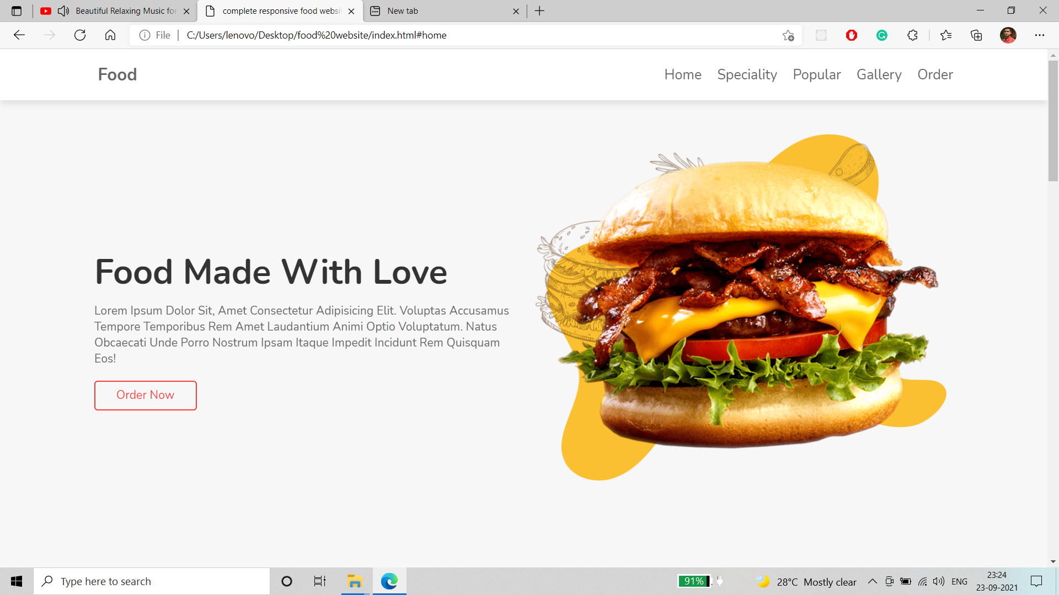
Title of the project :- Food Delivery Website Project members :- Sanjoy Saha Soumyadip Jana Stream- B.Tech in Computer Science & Engineering

Slide 2
Tech Stacks used :-
VS code
HTML
CSS
Javascript

Slide 3
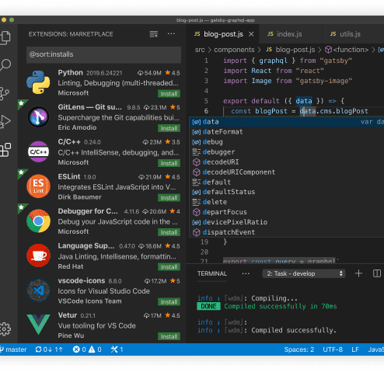
Q) What is VS Code?
VS Code stands for Visual Studio Code. It is a lightweight but powerful source code editor.
Developer: Microsoft
Written in: TypeScript, JavaScript,
HTML, and CSS

Slide 4
HTML
It stands for Hyper Text Markup Language.
Standard markup language for documents designed to be displayed on a web browser.
It is a set of tag elements which tell the browser what to display.
It is the skeleton of the webpage.
HTML tags -
<h1></h1> - Heading tags from h1 to h6
<a></a> - Anchor tag
<div></div> - div tag
<p></p> - Paragraph tag

Slide 5
CSS
CSS stands for Cascading Style Sheets
It is used to add style to the webpage and tells the browser how to display the content
CSS files are saved as .css
Multiple CSS stylesheets can be used in a single HTML file
You can write the same set of styles for multiple elements
Ex:-
h1{
color: green;
}

Slide 6
JavaScript
JavaScript is the Programming Language for the Web.
JavaScript can update and change both HTML and CSS.
JavaScript can calculate, manipulate and validate data.
JavaScript syntax is the set of rules, how JavaScript programs are constructed:
// How to create variables: var x; let y; // How to use variables: x = 5; y = 6; let z = x + y;

Slide 7
Food Delivery Website
First Page

Slide 8
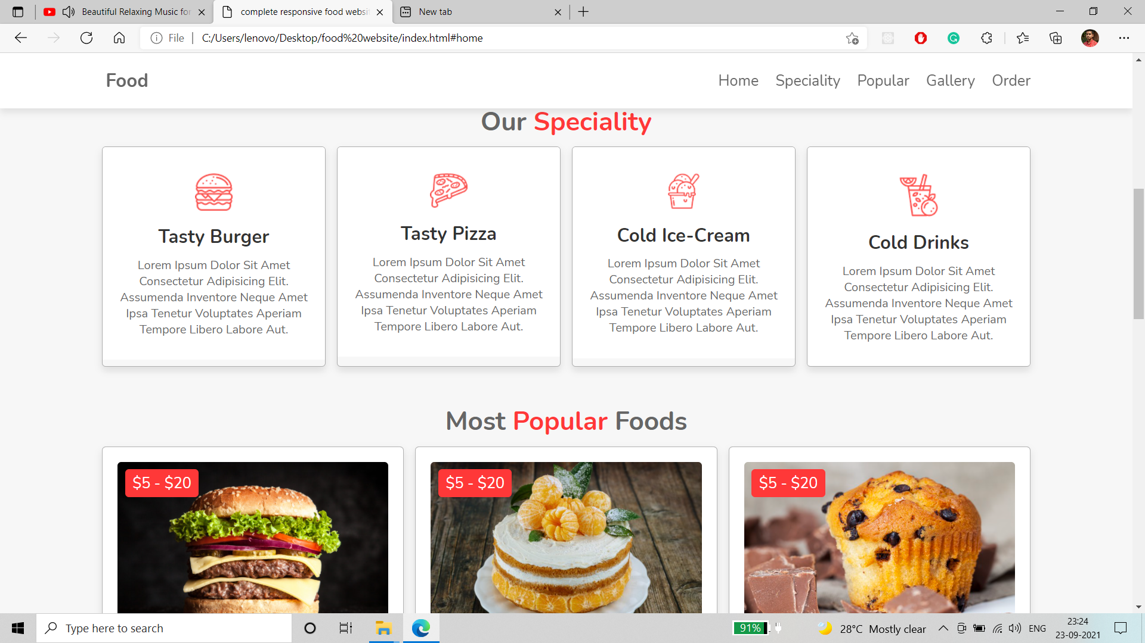
Representation of our website

Slide 9
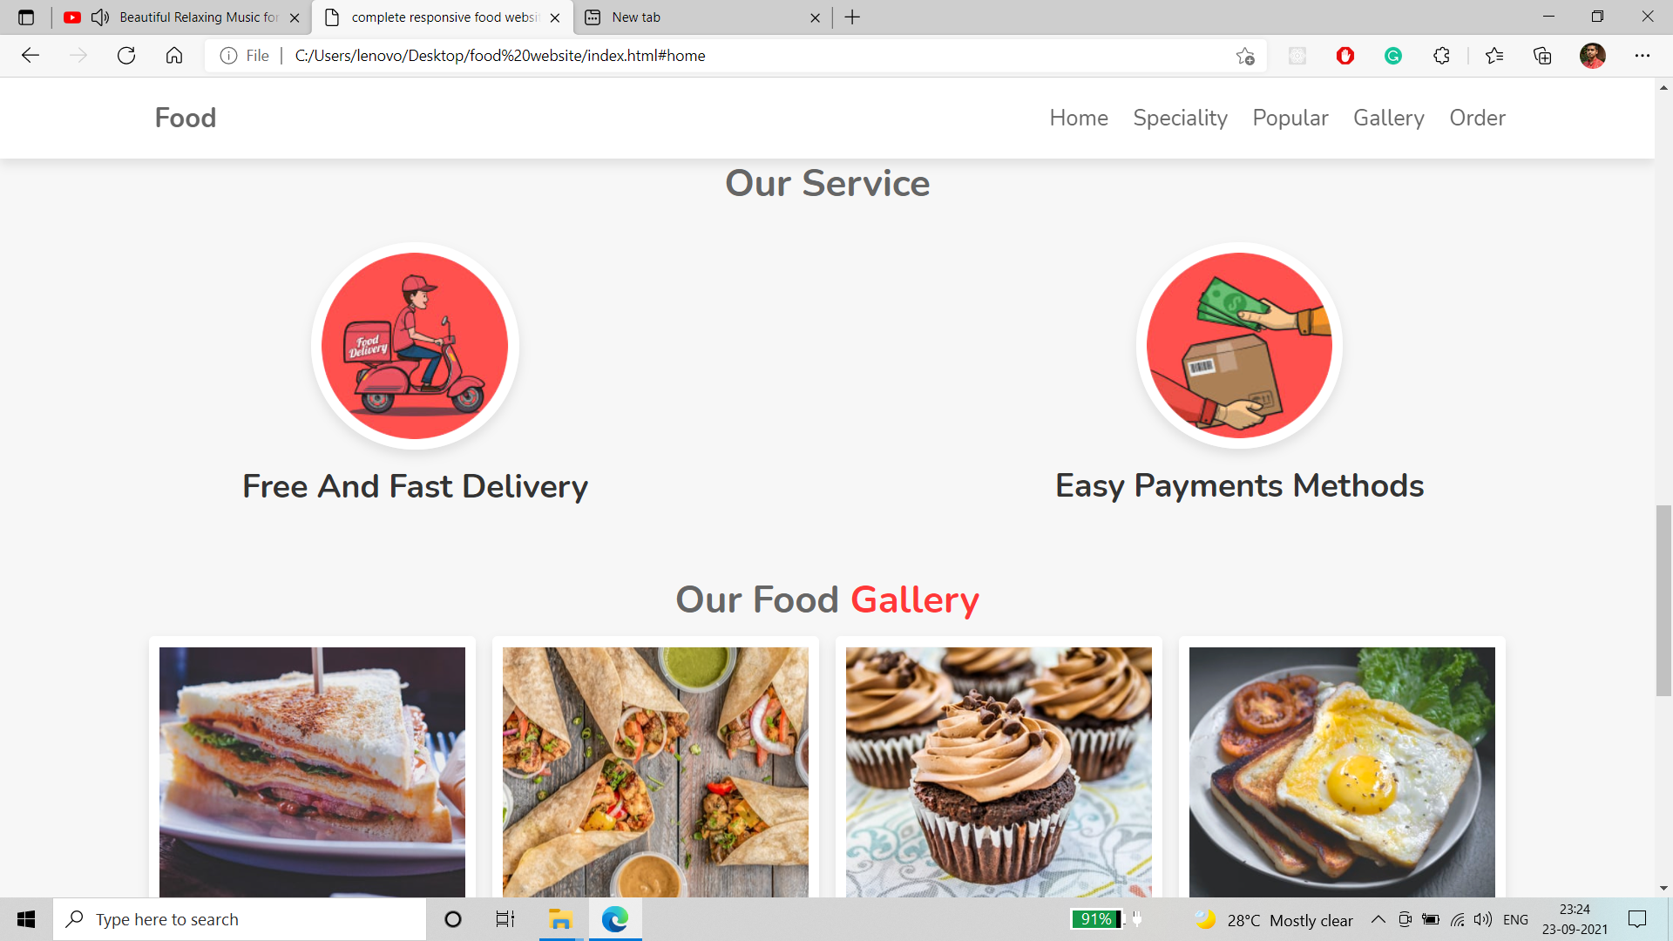
Delivery section & Food Gallery

Slide 10
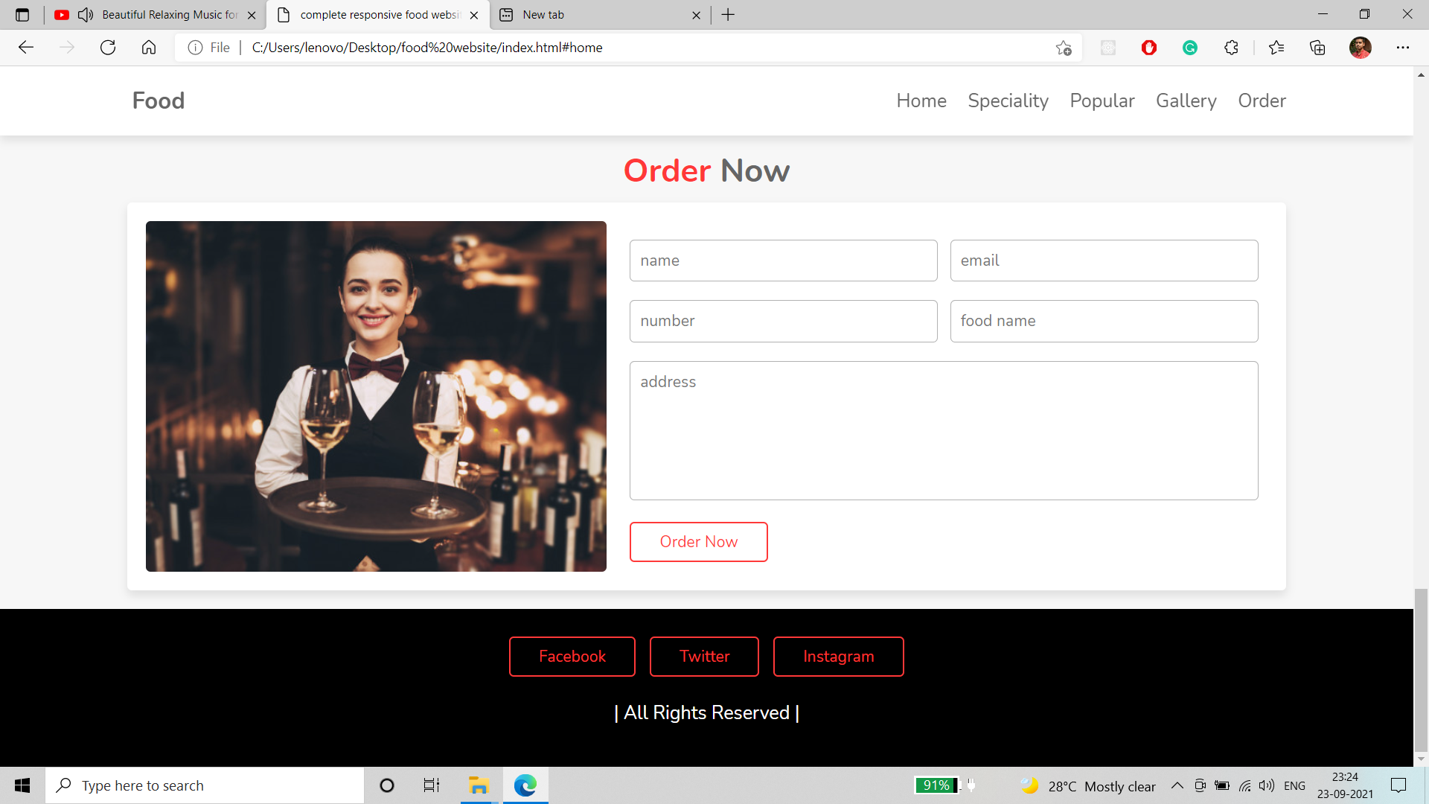
Login section

Slide 11
Thank You !

